Slide 1


Rafael Fernandes
05 May 2022

Slide 2

Outline
Executive Summary
Introduction
Methodology
Results
Conclusion
Appendix

Slide 3
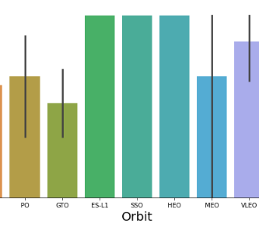
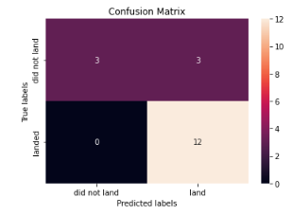
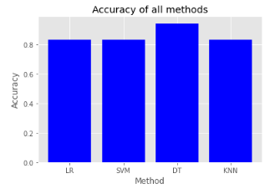
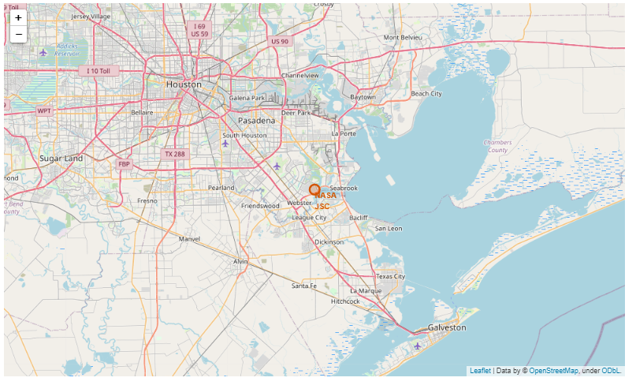
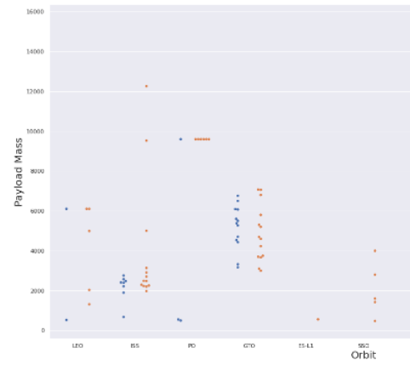
Executive Summary
Summary of methodologies
Data Collection with SQL, Web Scraping and API
Exploratory data and analysis
Create Maps with Folium
Create Predict Model to analysis the launch Space Y
Compared Classification Predict Model to find best
Summary of all results
Understanding data with Graphics Visuals and Interactive

Slide 4
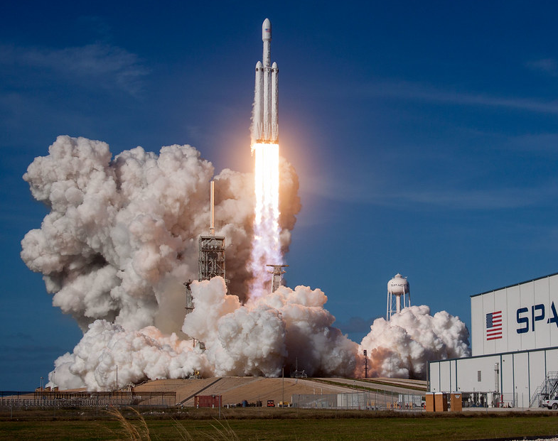
Introduction
Project background and context
The idea was to predict if the Falcon 9 will be land successfully. SpaceX advertises Falcon 9 rocket launches on its website with a cost about of 62 million dollars. Other providers cost upward about of 165 million dollar each, much of the savings is because SpaceX can reuse the first stage. Therefore, we can determine if the first stage will land successfully with bases data historical. This information can be used if an alternate company wants to bid against SpaceX for a rocket launch.
Problems you want to find answers
With what factors the rocket will land successfully?
The effect of each relationship of rocket variables on outcome.
Conditions which will aid SpaceX have to achieve the best results.

Slide 5

Methodology
Data Collection:
SpaceX rest API;
Web Scraping from Wikipedia;
Perform Data Wrangling:
One hot encoding data fields for machine learning and dropping irrelevant columns.
Data Analysis using Visualization and Sql:
Scatter, cat plots, bar chart to show patterns between data;
Interactive Visual Analytics:
Using Folium maps and Plotly Dash Visualizations;
Analysis and Model Predictive using Classification models:
Build and evaluate classification models;

Slide 6

Transform DataFrame
Finalize and Export file
Feature Engineering and manipulation
Xlsx, csv, …
Gathering Data from API
Data Collection
Data collection is the process of gathering and measuring information on targeted variables in an established system which then enables one to answer relevant questions and evaluate outcomes.

Slide 7

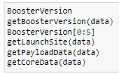
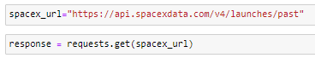
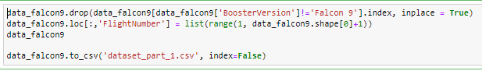
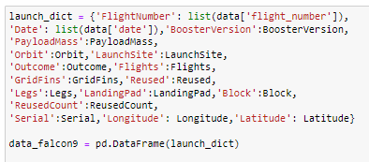
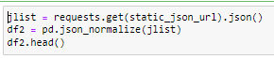
Data Collection – SpaceX API
Getting Response API
Converting Response in .json file
Apply functions and clean data
Transform list to dict then dataframe
Filtering dataframe and export file
GitHub URL

Slide 8
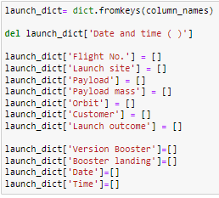
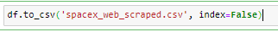
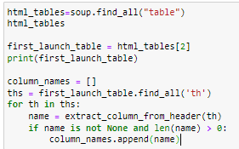
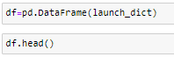
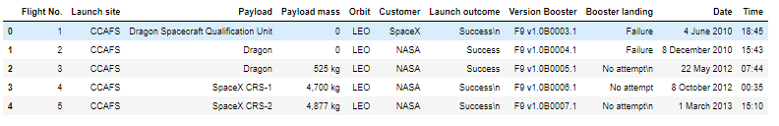
Data Collection – Scraping
Getting Response HTML and Create Soup Object
Finding tables and getting column names
Create dict, append data Keys and create new columns
Transform dict then dataframe
Export file
GitHub URL

Slide 9
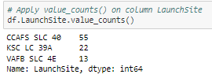
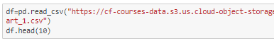
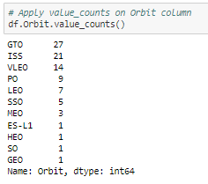
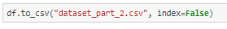
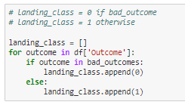
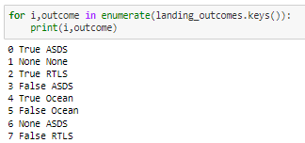
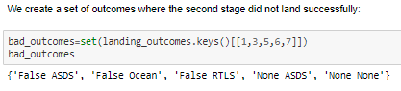
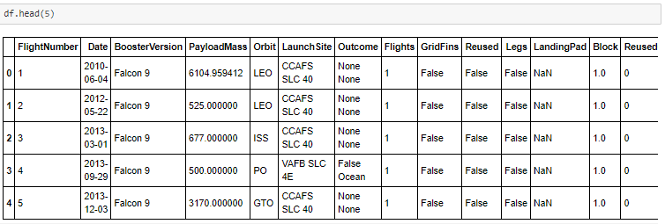
Data Collection – Wrangling
Load Data and Tranform DataFrame
Feature Engineering Cleaning Data
EDA
Transform to dict and Dataframe
Export file
GitHub URL

Slide 10


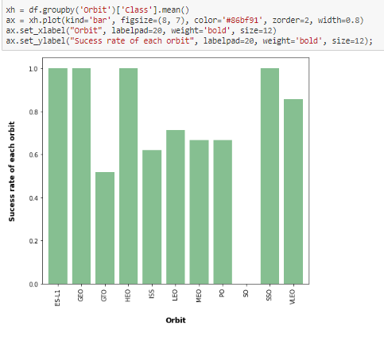
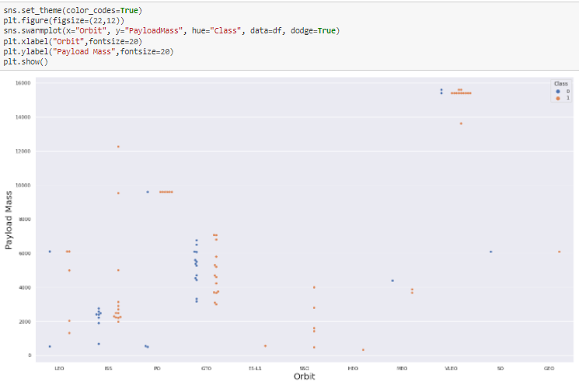
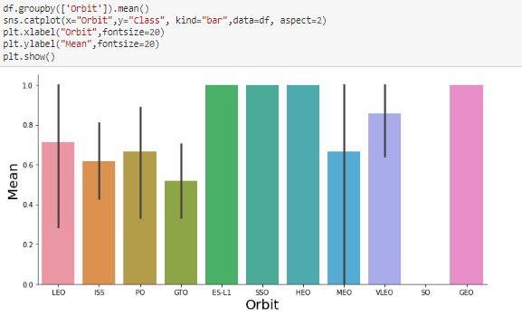
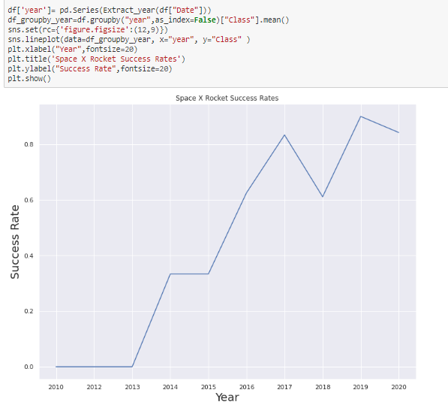
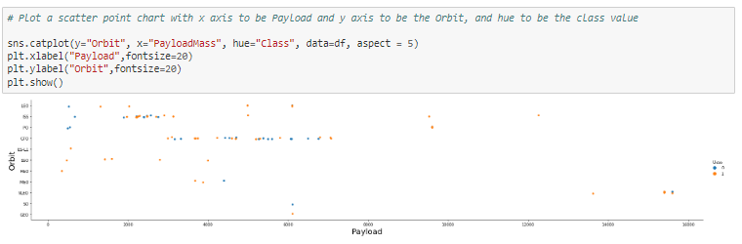
EDA with Data Visualization
Scatter Graphs Drawn
Bar Graphs Drawn
Lines Graphs Drawn
GitHub URL

Slide 11

GitHub URL
!pip install sqlalchemy==1.3.9
!pip install ibm_db_sa
!pip install ipython-sql
%load_ext sql
%sql ibm_db_sa://my-username:my-password@my-hostname:my-port/my-db-name
%sql SELECT DISTINCT LAUNCH_SITE FROM SPACEXTBL
Display the names of the unique launch sites in the space mission
Display 5 records where launch sites begin with the string 'CCA'
Display the total payload mass carried by boosters launched by NASA (CRS)
Display average payload mass carried by booster version F9 v1.1
List the date when the first successful landing outcome in ground pad was acheived.
List the names of the boosters which have success in drone ship and have payload mass greater than 4000 but less than 6000
List the total number of successful and failure mission outcomes
List the failed landing_outcomes in drone ship, their booster versions, and launch site names for in year 2015
Rank the count of landing outcomes (such as Failure (drone ship) or Success (ground pad)) between the date 2010-06-04 and 2017-03-20, in descending order
The skills necessary to be a good data scientist include being able to retrieve and work with data, and to do that you need to be well versed in SQL, the standard language for communicating with database systems.
Source: Coursera Site

Slide 12

GitHub URL
Build an Interactive Map with Folium
Objects Maps | Code | Outcome
Libraries Dash Construction | import folium from folium.plugins import MarkerCluster, MousePosition from folium.features import DivIcon | Use to be performing more interactive visual analytics of way easy. It’s possible to shown coordinates and added a Circle Marker around items.
Map Marker | Folium.Marker | Map object to make a mark on map
DivIcon | Folium.Icon | Create an icon on map
Circle Marker | Folium.Circle | Create a Circle where Marker is being placed
PolyLine | Folium.Polyline | Create a line between points
Marker Cluster Object | MarkerCluster | This is a good way to simplify a map containing many markers have the same coordinate
AntPath | Folium.plugins.AntPath | Create na animated line between points

Slide 13
GitHub URL
Build a Dashboard with Plotly Dash
Objects Maps | Code | Outcome
Libraries Dash Construction | import dash import dash_html_components as html import dash_core_components as dcc from dash.dependencies import Input, Output | Plotly is used for Data Viz Interactive graphs. Dash provides all of the available html tags as user-friendly python classes.
Pandas | import pandas as pd | Load file .csv and create dataframe
Plotly | import plotly.express as px | Plot the graphs
Dropdown | dcc.DropDown | Created for launch sites
RangeSlider | dcc.RangeSlider | Created for Payload Mass range selection
Pie Chart | px.pie | Created for Success percentagem display in relation to launch site.
Scatter Chart | px.scatter | Created for correlation display between Payload and Success for all sites or by certain launch site.

Slide 14
GitHub URL
Predictive Analysis (Classification)
Load feature engineered
data in dataframe
Finding Best Performing Classification Model
Evaluate Model
Check accuracy for each model
Transform it into Numpy arrays
Standardize and transform data
Split data into training and test data sets
Check how many test samples has been created
List down machine learning algorithms we want to use
Set our parameters and algorithms to GridSearchCV
Fit our datasets into the GridSearchCV objects and train our model
Get best hyperparameters for each type of algorithms
Plot Confusion Matrix
Y = data['Class'].to_numpy()
transform = preprocessing.StandardScaler()
X_train, X_test, Y_train, Y_test = train_test_split( X, Y, test_size=0.2, random_state=2)
Y_test.shape
Logistics Regression method - logreg_cv.score(X_test, Y_test))
Support Vector Machine method - svm_cv.score(X_test, Y_test))
Decision tree method - tree_cv.score(X_test, Y_test))
K nearsdt neighbors method - knn_cv.score(X_test, Y_test))
The model with best accuracy score wins the best performing model
yhat = knn_cv.predict(X_test)
plot_confusion_matrix(Y_test,yhat)

Slide 15
Results
Exploratory data analysis results
Interactive analytics demo in screenshots
Predictive analysis results

Slide 16

Section 2

Slide 17
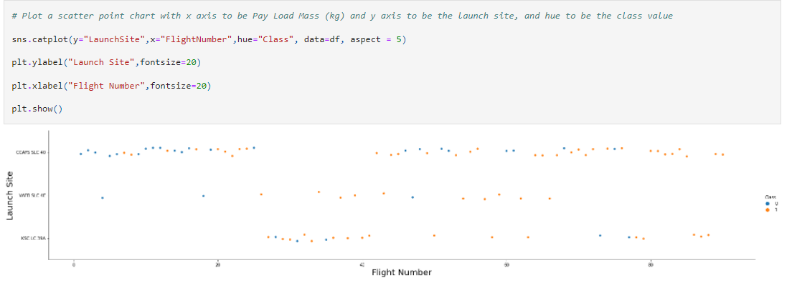
Flight Number vs. Launch Site
With higher flight numbers (greater than 30) the sucess rate for the Rocket is increasing

Slide 18
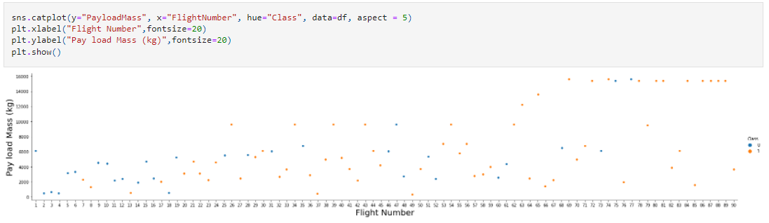
Payload vs. Launch Site
The greater the payload mass (greater than 7000kg) higher the success rate for the Rocket but there is no clear pattern to take a decision if the launch site is dependent on PayLoad Mass for a success launch

Slide 19
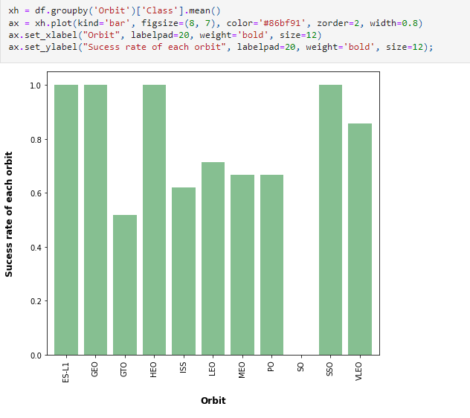
Success Rate vs. Orbit Type
ES-L1, GEO, HEO, SSO has highest Success Rates

Slide 20
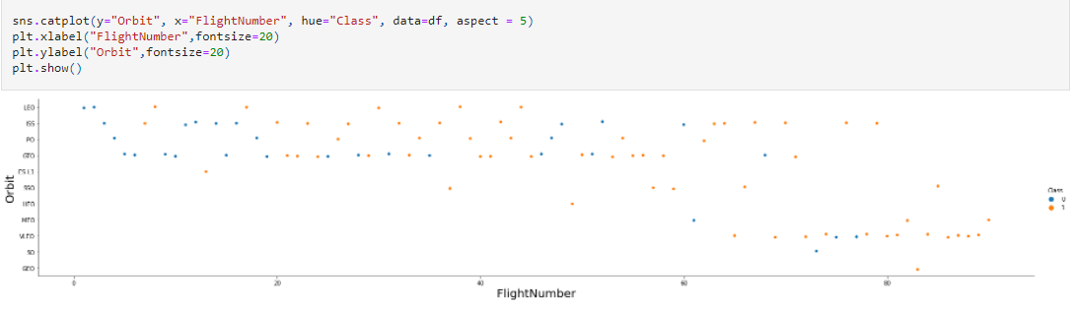
Flight Number vs. Orbit Type
We can see that for LEO orbit the success increases with the number of flights
On the other hand there seems to be no relationship between flight number and the GTO orbit

Slide 21
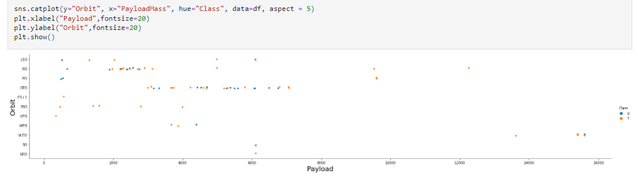
Payload vs. Orbit Type
We can observe that heavy a negative influence on MEO, GTO, VLEO orbits
Positive on LEO, ISS orbits

Slide 22
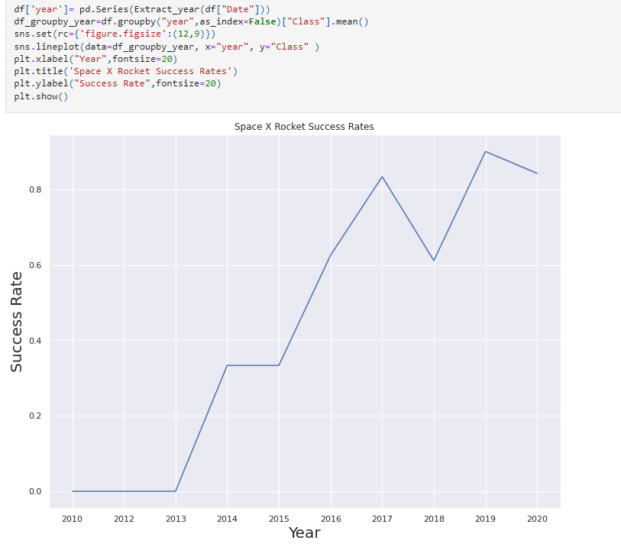
Launch Success Yearly Trend
We can observe that the success rate since 2013 kept increasing relatively though there is slight dip after 2019

Slide 23

EDA - SQL

Slide 24
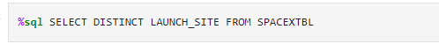
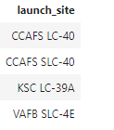
All Launch Site Names
Using the word DISTINCT in the query we pull unique values for 'launch_site' column from table SPACEX

Slide 25

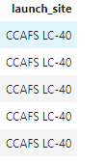
All Launch Site Names Launch Site Names Begin with 'CCA'
Using keyword 'limit 5' in the query we fetch 5 records from table SPACEX and with condition 'like' keyword with wild card 'cca%'. The percentage in the end suggests that the 'launch_site' name must start with 'cca'

Slide 26
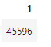
Total Payload Mass
Using function SUM calculates the total in the column 'payload_mass_kg_' and 'where' clause filters the data to fetch 'customer' by name 'nasa(crs)'

Slide 27
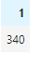
Average Payload Mass by F9 v1.1
1
Using the function 'avg' works out the average in the column 'payload_mass_kg_.
The 'where' clause filters the dataset to only perform calculations on 'booster_version "f9 v1.1“’.

Slide 28
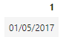
First Successful Ground Landing Date
Using the function 'min' works out the minimium date in the column 'date' and 'where' clause filters the data to only perform calculations on 'landing_outcome' with values 'success (ground pad)'.

Slide 29
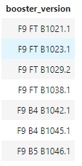
Successful Drone Ship Landing with Payload between 4000 and 6000
Selecting only 'booster_version' 'where' clause filters the dataset to 'landing_outcome = success (drone ship)' 'and' clause specifies additional filter conditions 'payload_mass_kg_ > 4000 and payload_mass_kg_ < 6000'

Slide 30
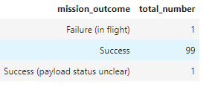
Total Number of Successful and Failure Mission Outcomes
Selecting multiple count is a complex query. I have used case clause within subquery for getting both success and failure counts in same query.

Slide 31
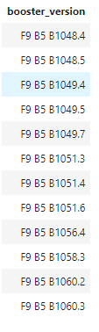
Boosters Carried Maximum Payload
Using the function 'max' works out the maximum payload in the column 'payload_mass_kg_'

Slide 32
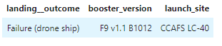
2015 Launch Records
We need to list the records which will display the month names, failure 'landing_outcomes' in drone ship, booster versionn, launch_site for the months in year 2015

Slide 33
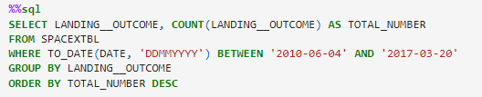
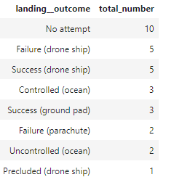
Rank Landing Outcomes Between 2010-06-04 and 2017-03-20

Slide 34

Section 3
Folium

Slide 35
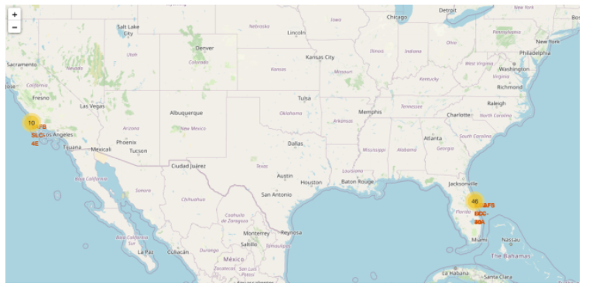
All launch sites location markers on a global map
We can that the SpaceX launch sites are near to the USA coasts Floripa and California regions

Slide 36
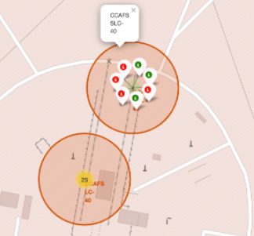
Color-labeled launch outcomes on the map
Green Marker showns successful launches and Red Marker shows failures

Slide 37
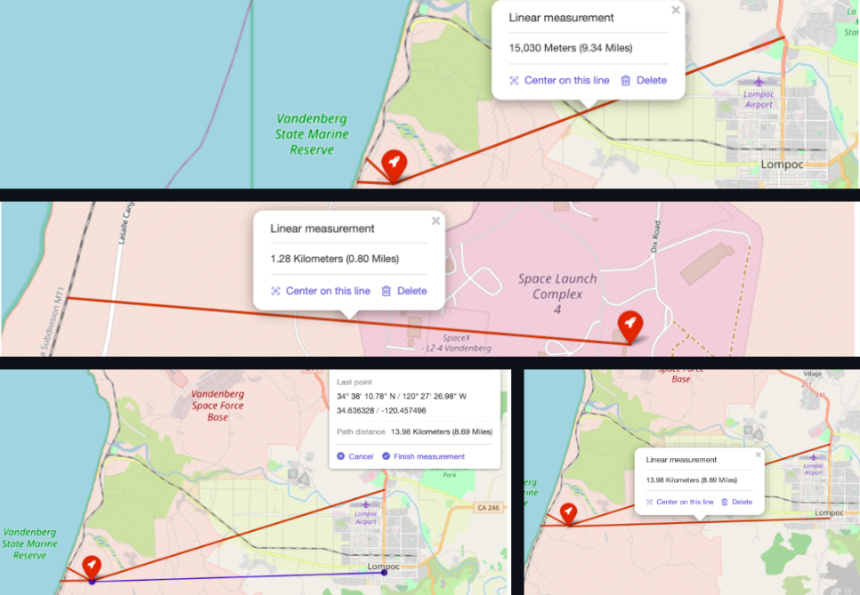
Launch site to its proximities

Slide 38

Section 4

Slide 39

Launch Success for All Sites - Count
We can see that KSC LC-39A had the most successful launches from all the sites

Slide 40

Launch site Highest Success Ratio Launch
KSC LC-39A achieved a 76,9% success rate while getting a 23,1 failure rate

Slide 41

Payload vs. Launch Outcome scatter plot for all sites
We can see the success rates for low weighted payloads is higher than the heavy weighted payloads

Slide 42

Section 5

Slide 43

Classification Accuracy – All models predict

Slide 44

Confusion Matrix – Decision Tree Classifier best score

Slide 45
Conclusions
Orbits ES-L1, GEO, HEO, SSO has highest success rates
Success rates for SpaceX launches has been increasing relatively with time and it looks like soon they will reach the required target
KSC LC-39A had the most successful launches but increasing payload mass seems to have negative impact on success
Decision Tree Classifier algorithms is the best for machine learning model for provided dataset

Slide 46


